Slide 1
MATHEMATICAL MODELING OF DC, STEPPER AND SERVO MOTORS
Team: Aadhar Patel, Arshaan Lakhani, Ishan Patel, Paarth Patel
Course: Dynamic System Modeling (702MH0C023)
B.Tech Mechatronics, Sem IV | NMIMS MPSTME Mumbai
Category: E| Complexity: Medium
COs Exercised: [CO1, CO2, CO3, CO4, CO5] | Date: 19/04/2026

Slide 2
1. System Introduction & Motivation
The system under study consists of three types of electric motors
DC, stepper and servo motor, which convert electrical energy into mechanical motion.
  A DC motor provides continuous rotational motion.
  A stepper motor produces discrete angular steps.
  A servo motor enables precise position, velocity, and acceleration control using feedback.
These motors are fundamental in modern engineering systems
  DC Motors → conveyors, fans, electric vehicles
  Stepper Motors → 3D printers, CNC machines, robotics
  Servo Motors → robotic arms, aerospace systems, automation
What question are we answering?
How can we mathematically model DC, stepper, and servo motors using physical laws (FBD, electrical laws), and represent them in forms suitable for analysis such as differential equations and state-space models?
Notes:
TIMING: 0:00-1:00 (1 min)
FOCUS: Introduce your system and its real-world engineering relevance.
TIP: Start with a compelling application, not a textbook definition.
SHOW: An image or short video of the actual system.

Slide 3
Problem Formulation & Assumptions for DC Motor
Inputs
  Voltage: V(t)
  Load torque disturbance: T_L(t)
Outputs
  Angular velocity: \omega(t) and Angular position: \theta(t)
State Variables
  x_1 = \omega(t) (angular velocity)
  x_2 = i(t) (armature current)
Parameters
  J: Moment of inertia
  B: Viscous friction coefficient
  R: Armature resistance
  L: Armature inductance
  K_t: Torque constant
  K_e: Back EMF constant
DOF = 1. Only one independent mechanical motion: shaft rotation
Notes:
TIMING: 1:00-2:30 (1.5 min)
FOCUS: Clearly define I/O, states, parameters, DOF, and justify every assumption.
TIP: Explain WHY each assumption is physically valid.
BE PREPARED: You may be asked 'Why this assumption? What if it changes?'

Slide 4
Problem Formulation & Assumptions for Stepper Motor
Inputs
  Phase voltages: V_A(t), V_B(t)
  Pulse sequence (digital control input)
Outputs
  Angular position: \theta(t)
  Step position (discrete)
State Variables
  x_1 = \theta(t)
  x_2 = \dot{\theta}(t)
  x_3 = i_A(t)
  x_4 = i_B(t)
Parameters
  J: Rotor inertia
  B: Damping coefficient
  R, L: Phase resistance & inductance
  K_m: Motor torque constant
DOF = 1. Only one mechanical motion: rotor angle (theta)
Notes:
TIMING: 1:00-2:30 (1.5 min)
FOCUS: Clearly define I/O, states, parameters, DOF, and justify every assumption.
TIP: Explain WHY each assumption is physically valid.
BE PREPARED: You may be asked 'Why this assumption? What if it changes?'

Slide 5
Problem Formulation & Assumptions for Servo Motor
Inputs
  Control voltage: V(t)
  Reference input (desired position): \theta_{ref}(t)
  Load torque: T_L(t)
Outputs
  Angular position: \theta(t)
  Angular velocity: \dot{\theta}(t)
State Variables
  x_1 = \theta(t)
  x_2 = \dot{\theta}(t)
  x_3 = i(t)
Parameters
  J: Inertia
  B: Damping coefficient
  R, L: Electrical parameters
  K_t, K_e: Motor constants
  Controller gain (if included): K_p, K_d, etc.
DOF = 1. Only one motion: shaft rotation.
Notes:
TIMING: 1:00-2:30 (1.5 min)
FOCUS: Clearly define I/O, states, parameters, DOF, and justify every assumption.
TIP: Explain WHY each assumption is physically valid.
BE PREPARED: You may be asked 'Why this assumption? What if it changes?'

Slide 6
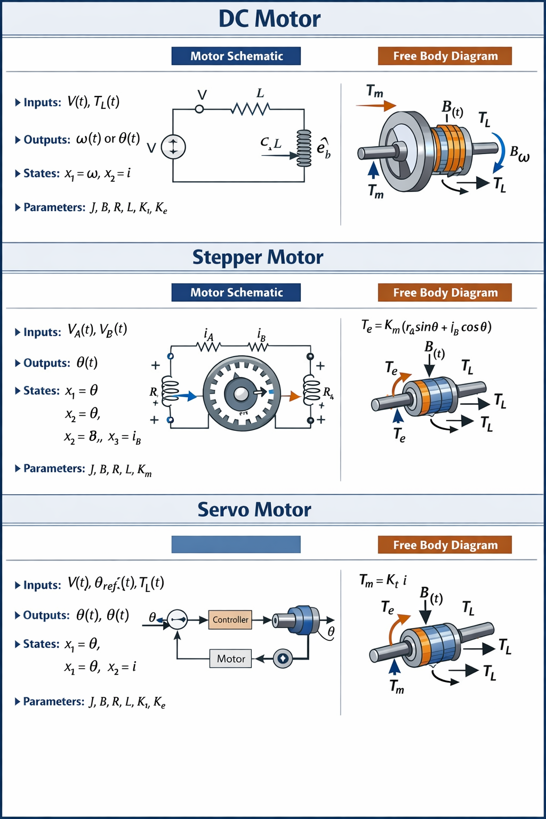
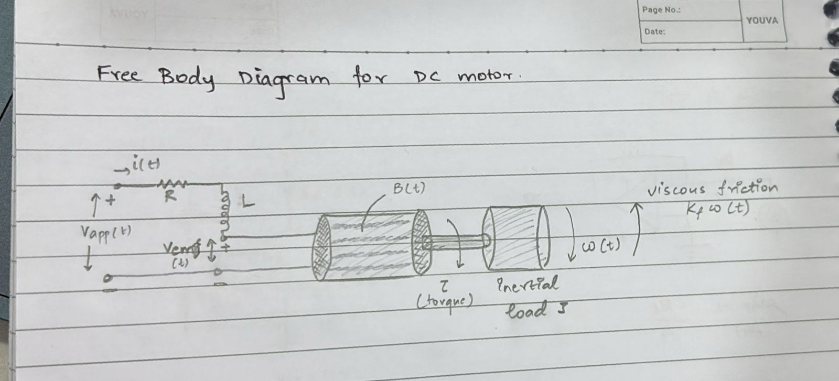
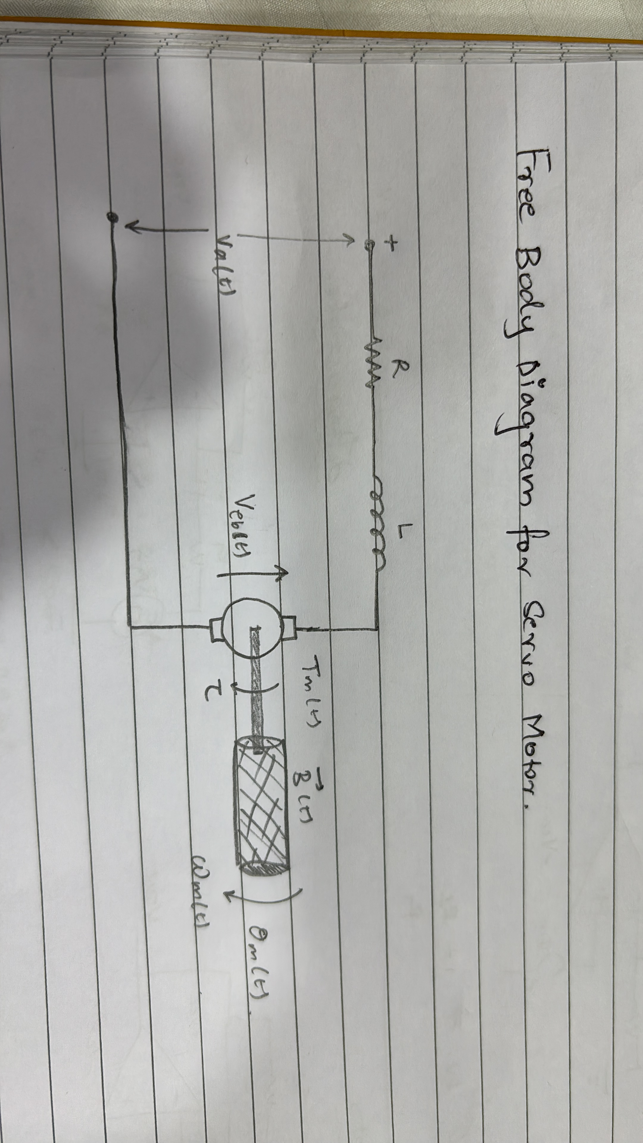
3. Free Body Diagram / System Schematic

Slide 7
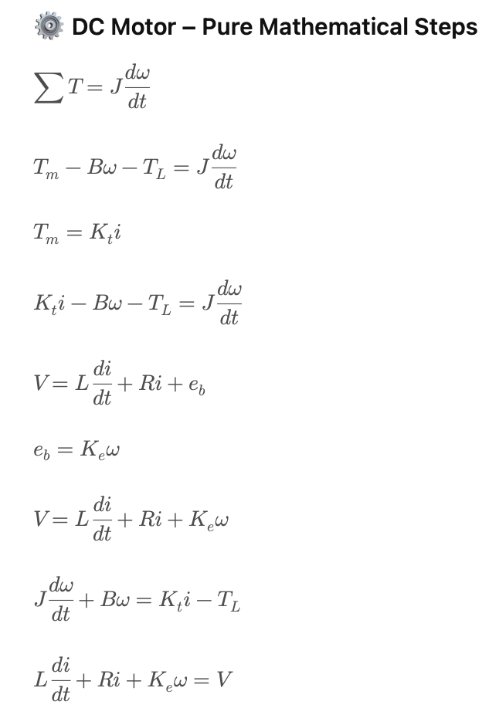
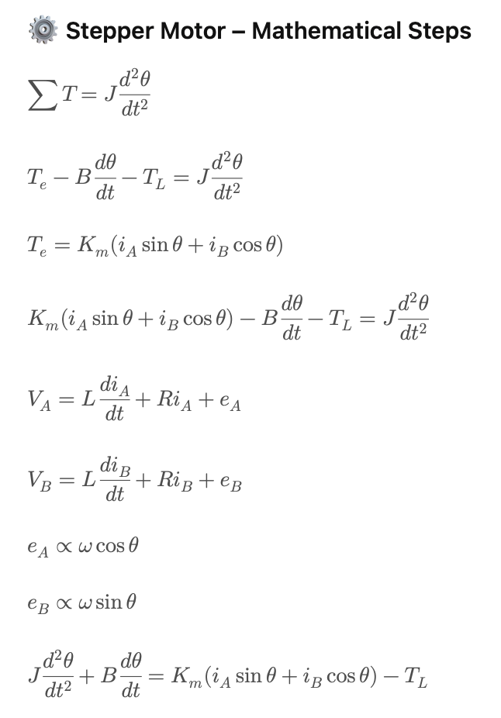
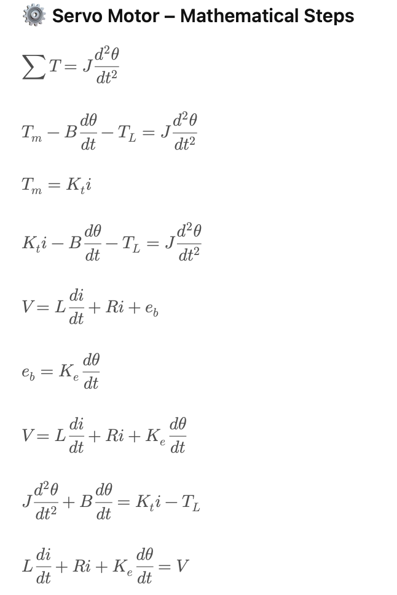
4. Mathematical Derivation (Part 1)
Method: Newton – Euler Method
Notes:
TIMING: 2:30-3:45 (1.25 min)
FOCUS: Walk through EVERY step of the derivation. This is the most important section.
TIP: Show the algebra — don't skip to the final equation.
BE PREPARED: You may be asked to explain any step in detail.

Slide 8
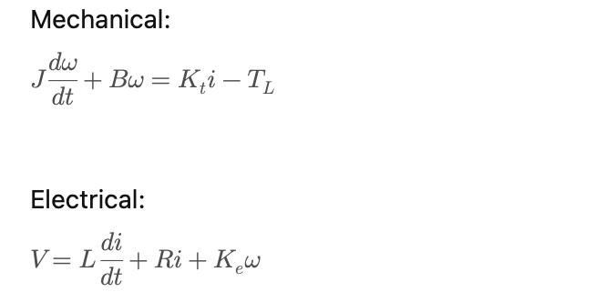
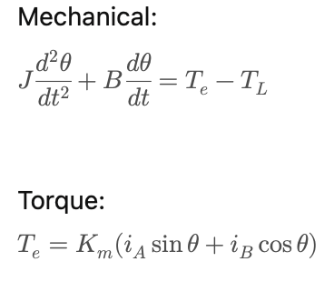
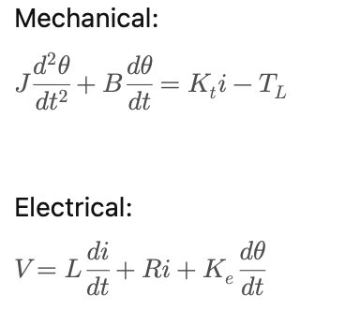
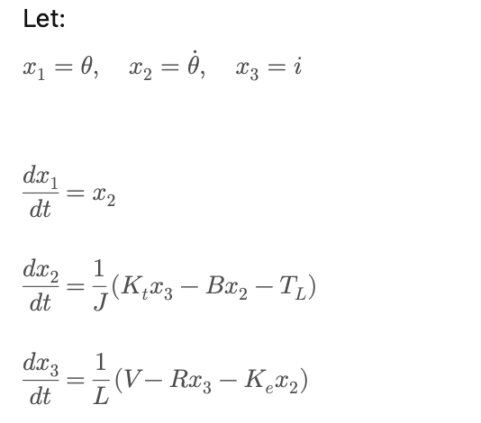
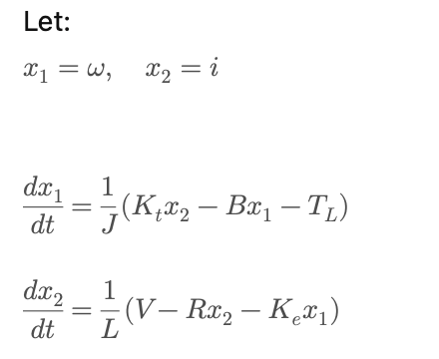
5. Final Equations & State-Space
FINAL EQUATIONS AND STATE SPACE FOR DC, STEPPER AND SERVO MOTOR
DC MOTOR STEPPER MOTOR SERVO MOTOR
State space of stepper is non-linear due to sin and cosine terms
Notes:
TIMING: 3:45-5:00 (1.25 min)
FOCUS: Present final EOM and state-space. Explain the physical meaning of EVERY term.
TIP: 'c*x_dot = viscous damping force' is stronger than just showing the equation.

Slide 9
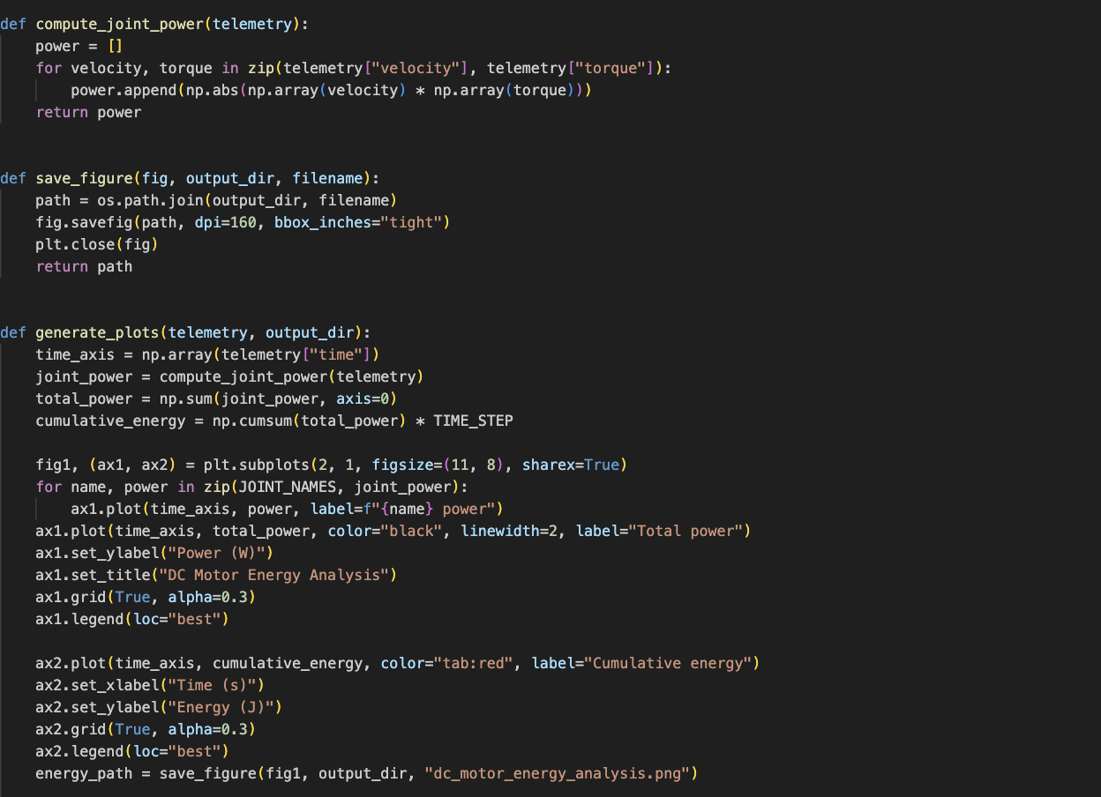
6. Simulation & Energy Analysis
Notes:
TIMING: 5:00-7:00 (2 min) Screenshot 2026-04-20 at 12.14.18 AM
FOCUS: Show your simulation setup, key code snippet, and output plots.
INCLUDE: Energy vs time plot — this validates your model physically.
BE PREPARED: You may be asked 'Why does the oscillation decay?' or 'How does energy change?'

Slide 10
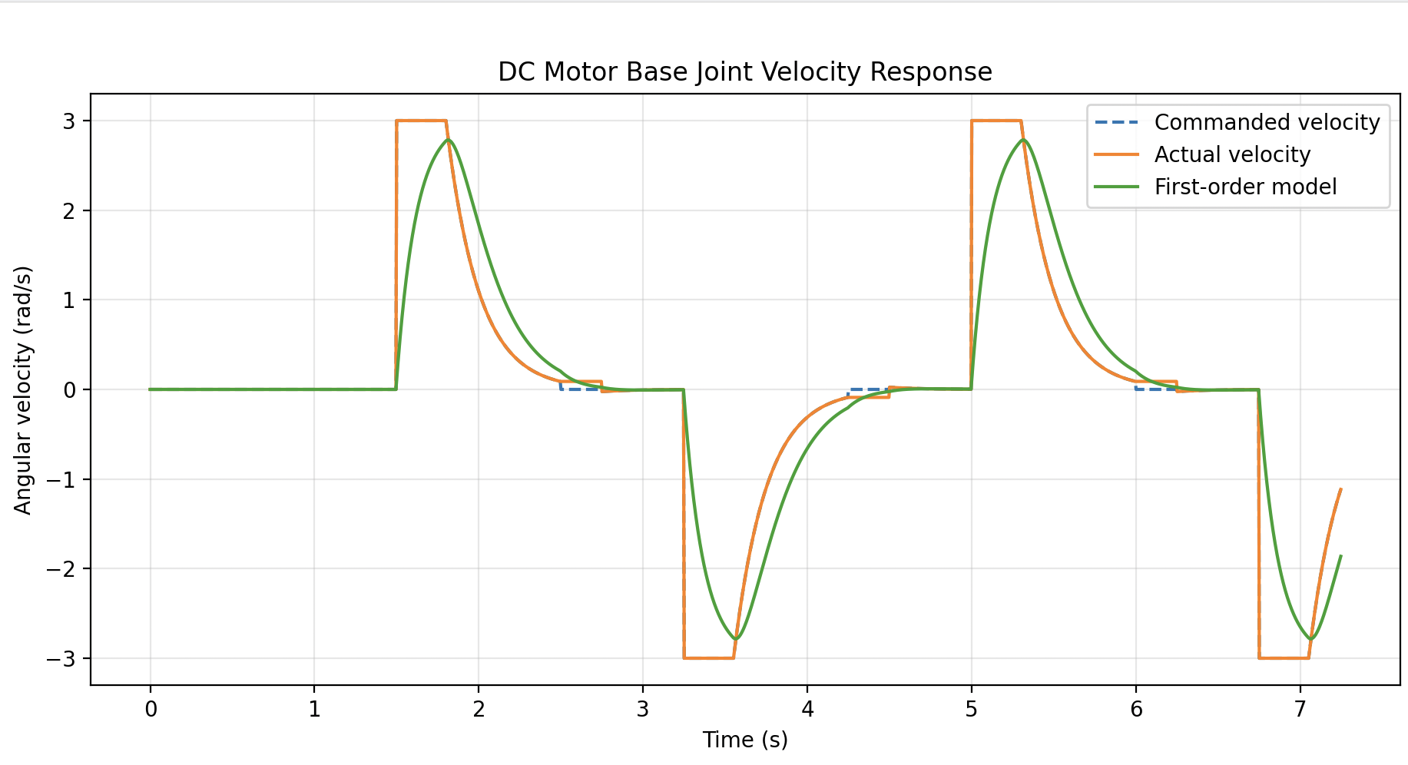
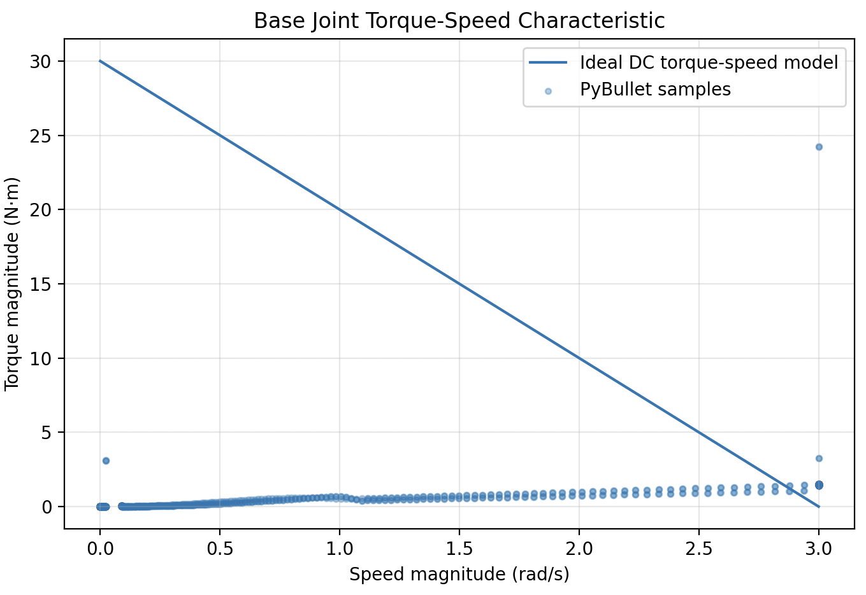
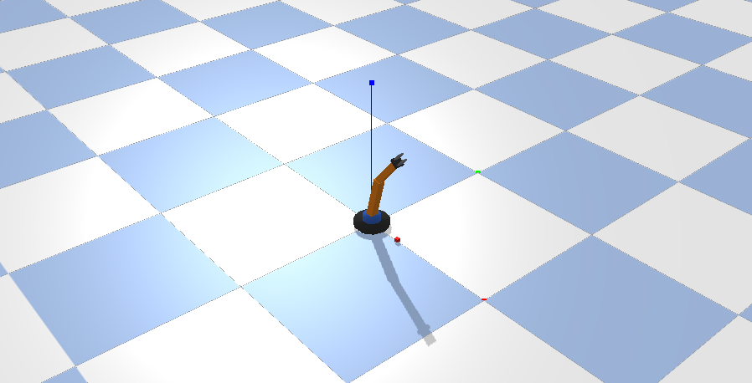
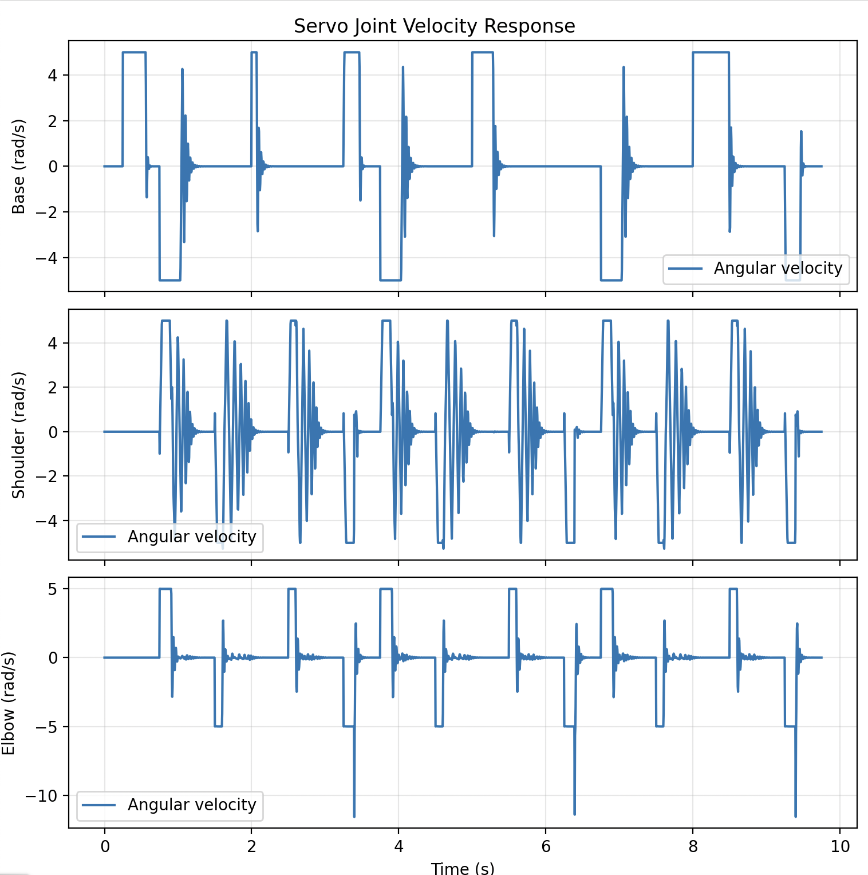
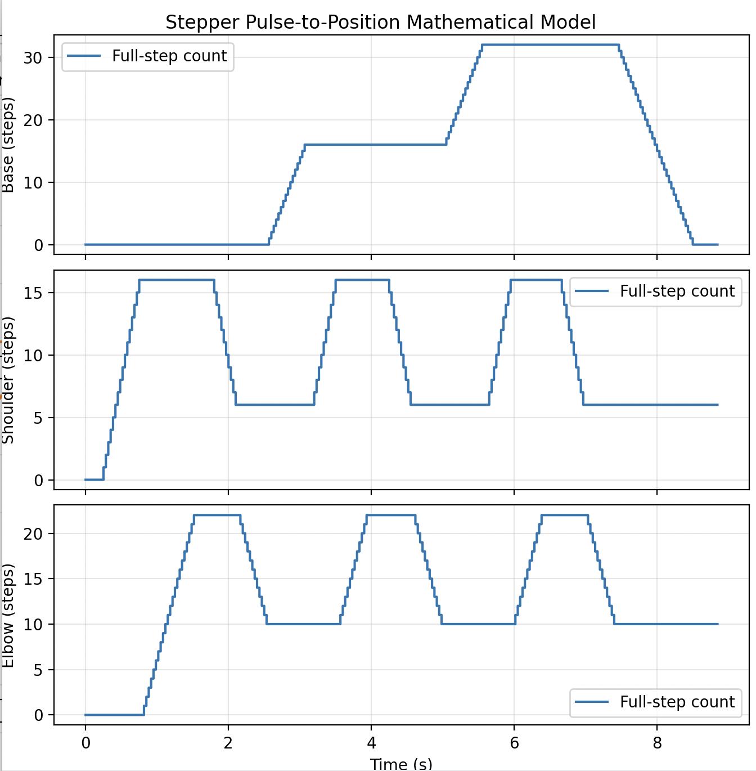
7. Simulation Visualization

Slide 11
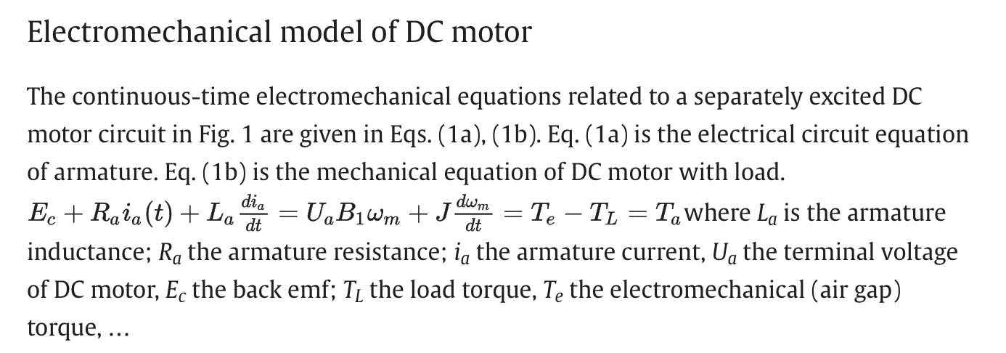
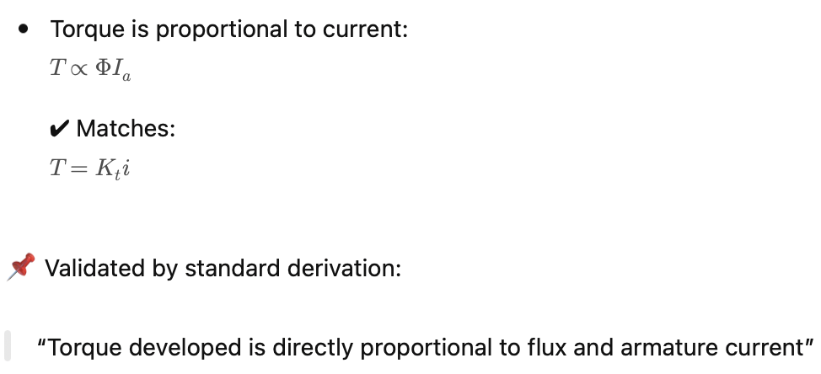
8. Validation & Analysis
Validation of DC
Validation of Stepper
Notes:
TIMING: 7:00-8:30 (1.5 min)
FOCUS: Show HOW you verified your results. Energy check, textbook comparison, sensitivity.
TIP: A strong answer = 'We compared natural frequency with Ginsberg Ch.3.'
A weak answer = 'It runs and produces output.'

Slide 12
9. Conclusions & Reflections
The mathematical models of DC, stepper, and servo motors were successfully derived and validated, showing that DC and servo motors are linear systems while the stepper motor is nonlinear.
Key Finding: The models accurately represent electromechanical energy conversion and system dynamics, matching standard textbook formulations.
What we learned that a textbook couldn’t teach: Converting real systems into equations requires proper assumptions and interpretation; CO2 (FBD) was the most challenging concept.
What we would do differently: Start early with simulation tools and improve validation of assumptions and intermediate steps.
Course units most critical & CO Self-Assessment: Kinematics, FBD, Forces, Laws, and Energy were essential;
CO1 ✓ CO2 ✓ CO3 ✓ CO4 ✓ CO5 ✓
Notes:
TIMING: 8:30-10:00 (1.5 min)
FOCUS: Be specific about what you learned and what was hardest.
TIP: 'Getting the sign convention right in the Lagrangian took 3 iterations' is much stronger than 'teamwork was hard.'
INCLUDE: CO self-assessment — which COs did you exercise most?

Slide 13
10. References & AI Disclosure
Electrical equivalent circuit based modeling and analysis of direct current motors
Textbook References:
[1] Ginsberg, J. (2008). Engineering Dynamics. Cambridge UP.
[2] Electrical equivalent circuit based modeling and analysis of direct current motors by Ali Bekir Yeldiz
Online Resources:
https://www.electricalsblog.com/torque-equation-of-dc-motor-derivation?utm_source=chatgpt.com
AI Tools
Tool: ChatGPT-4o, Antigravity, Codex
Purpose: Mathematical help, Python syntax debugging
NOT used for: Equations of Motion, Derivation done by hand
Notes:
AI disclosure is MANDATORY but NOT penalized.
Be honest about what tools you used and for what purpose.
Good: 'Used ChatGPT for Python syntax debugging, derivation done by hand.'
Non-disclosure IS penalized if uncovered during Q&A.

Slide 14
Thank You — Questions?
Team: Aadhar Patel, Arshaan Lakhani, Ishan Patel, Paarth Patel
Project: Mathematical Modelling of DC, Stepper and Servo Motor
Category: [E]
COs: [CO1-CO5]
[ALL members prepared for Q&A — evaluators may direct to specific members]

